Slide 1
Safety Manager

Slide 2
AGENDA
System View of Managing Safety
The Service we call Safety Manager
Demo of how we provide Safety Manager as a Service

Slide 3
How I have felt as a manager

Slide 4
Systems View of Managing Safety
Leading and Lagging indicators across all systems
Safety Situational Awareness across all systems
Hazard Management
Control Effectiveness
Best Practices
Improvements
Risk Management
Assets (Visibility/Reliability)
Training
Planning
BBS and/or HPI
Audit and Investigation
Maintenance
ROI and Budgeting
Understanding
Judgement
ERP
HR
JHA/JSA
Req Training
Risk Decisions
Observations
Knowledge/Implementation
PROD
Learning
Controls
ID Risks
Capabilities
Continuous Improvement
Information/Documentation
People
Processing
Hazards
Production
Tasks
Compliance
Equipment
Conditions
Location
Data
Cost

Slide 5
Service to digitize and automate safety management
Provided by safety professions not software developers
Not a specific software or platform
Prevent stove pipe (single focus, one size fits none)
Allows user to determine form, fit, and function
Integrate into any system you have or want to use
An environment (blank slate and completely tailorable)
Data Collection and/or Data Discovery
On-line or off-line
Manual entry or automatic
Data structure is customizable
Manage Information (edit, update, send, receive, visualize)

Slide 6
Demo
Data collection plan
Managing information using an administrative console
Safety Situational Awareness across all systems

Slide 7
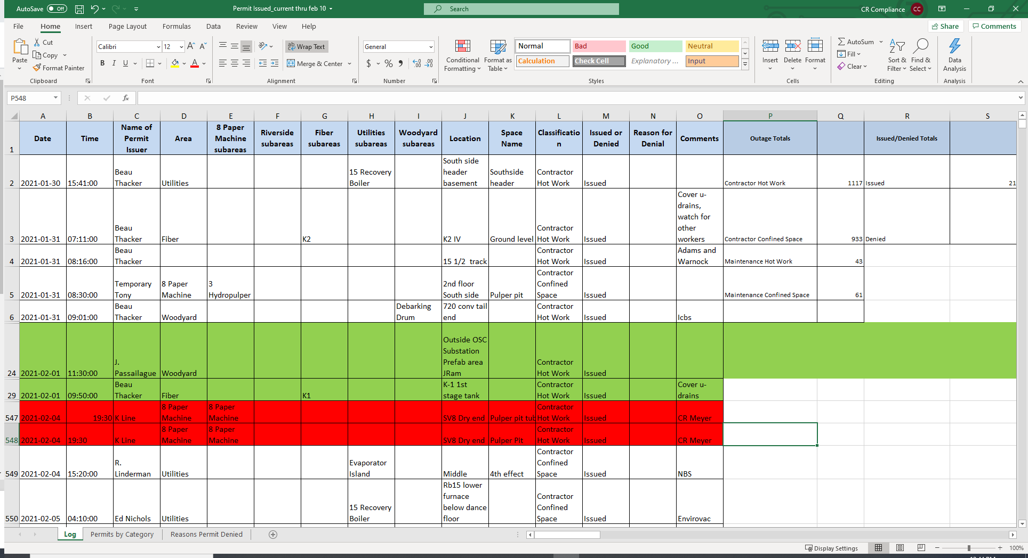
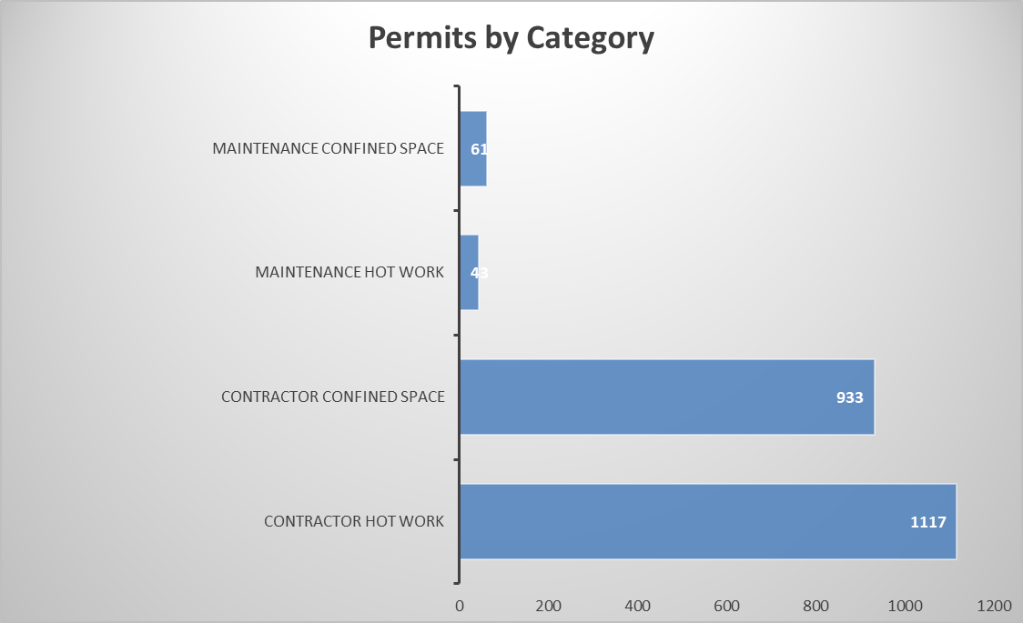
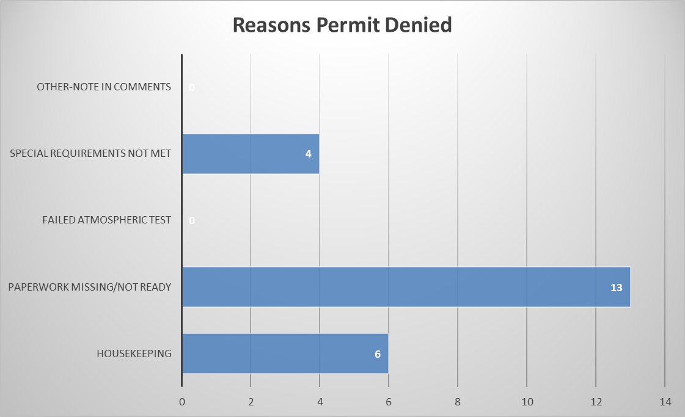

Slide 8
Comments / Questions

